Slide 1


-P2P2P-
“PlusCal to PlantUML to PDF”
Juan José Serrano, Alejandro Benito, Jackson Belzer & Christian Lamb
2026 Undergraduate Symposium
Notes:
Hi everyone, we are Blueprint Jacks, and today we present P2P2P —
the VS Code extension we have been deveioping which turns
PlusCal to PlantUML to PDF.

Slide 2

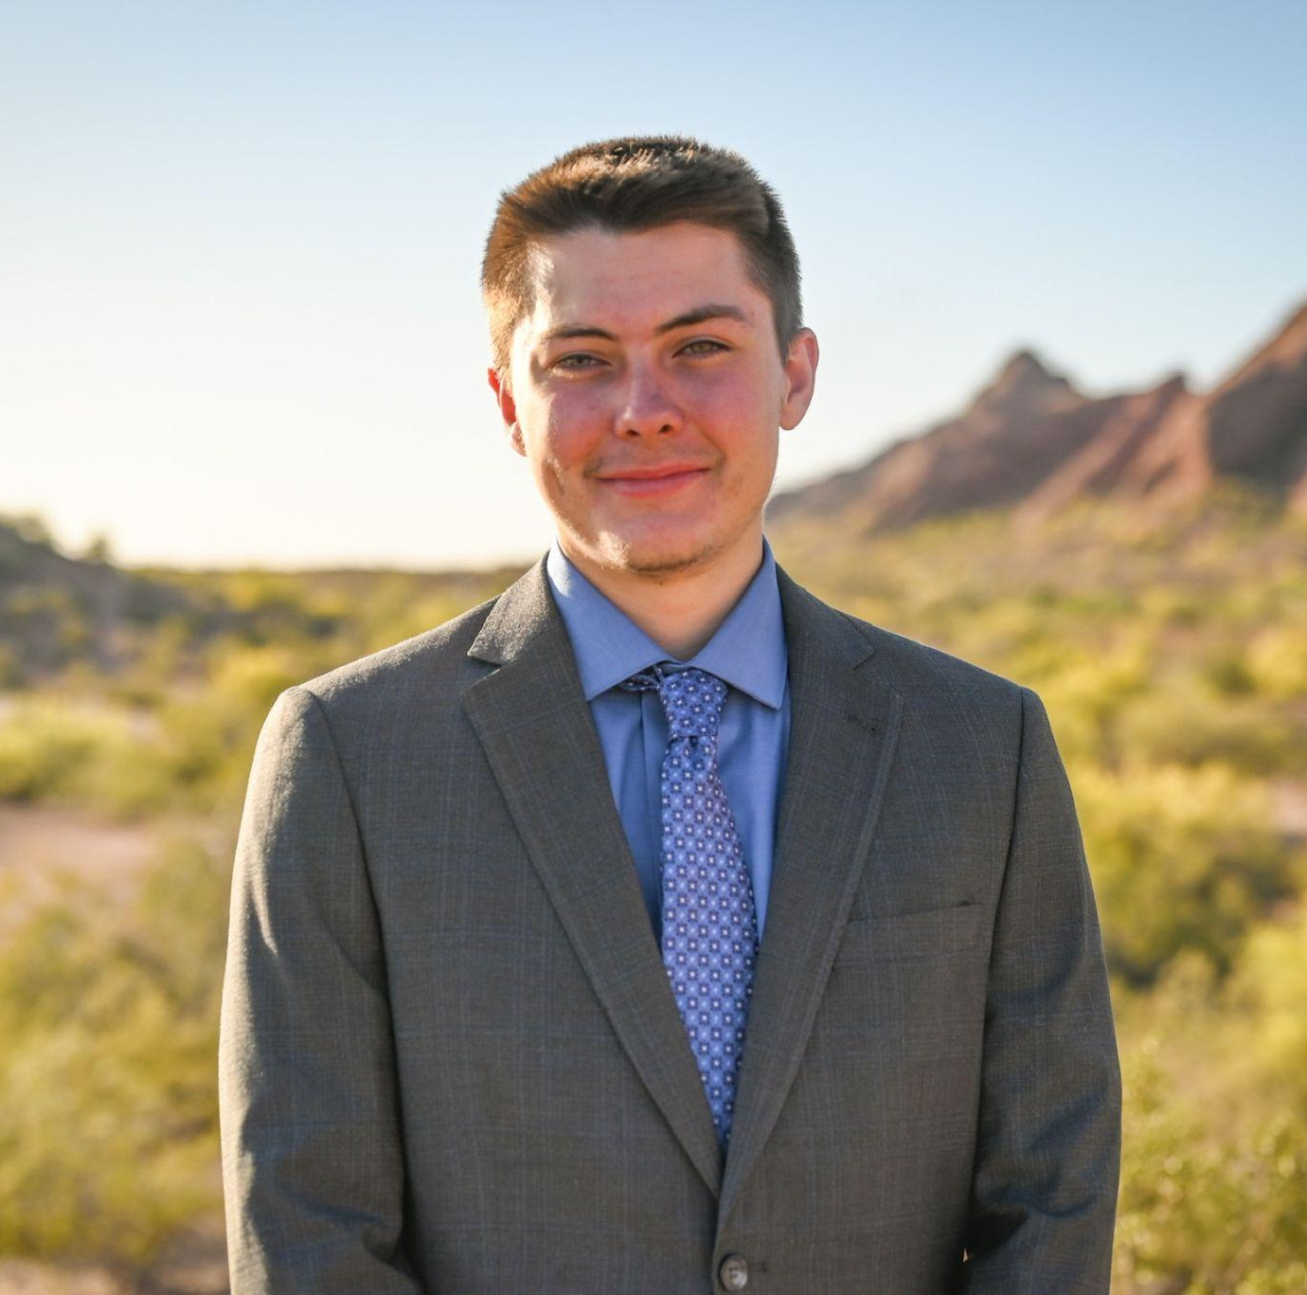



Meet Our Team
Alejandro Benito
Release Manager
Christian Lamb Recorder
Ogonna Eli
Faculty Mentor
Jackson Belzer
Team Lead
Juan Jose Serrano
Architect
Notes:
Faculty Mentor Ogonna Eli
Christian Recorder
Alejandro Release Manager
Juan Architect
Jackson Team Lead

Slide 3


Meet Our Client
Chris Ortiz
Senior Technologist,
Tools & Infrastructure
Rex Jackson
Vice President, Tools & Infrastructure
Notes:
Our client is SanDisk
We work directly with Chris Ortiz, the senior technologist and Rex Jackson the vp over tools and infrastructure Our goal is to support these firmware engineers and encourage the transition towards formal verification methods.

Slide 4
Project Domain & Core Need
Verification-Driven Firmware Design in the Enterprise Storage Industry
SanDisk engineers design complex firmware systems that must be reliable, reviewable, and formally verified
Core Need
Automatically generate trusted, professional documentation
directly from verified PlusCal models
Notes:
As a quick recap on our domain: we’re working in verification driven - firmware design for enterprise storage.
At SanDisk, engineers build systems where reliability is critical and the work needs to be easy to review and formally verify.
So, the core need we’re solving is simple: we automatically generate trusted, professional documentation from verified PlusCal models,
So that teams can review and share outputs without the diagram and models drifting apart.

Slide 5
SanDisk’s Current Workflow
01
02
03
04
05
English Specs
UML Diagrams
Reviews
Verification
PDF
Notes:
Now, we are going to talk about SanDisk’s current workflow
First, Sandisk writes their specifications in english and pseudocode.
After that, UML diagrams are made by hand.
Then, the reviews between teams are slow and once again manual.
Finally, the big problem is that nothing guarantees the diagram matches the behavior that was actually verified in the first place, and the final PDF of this design is exported manually.

Slide 6
SanDisk’s Problem
Manual reviews fall short
Different audiences, different formats
No automatic synchronization
Notes:
Before we talk about the solution, let’s quickly look at the core challenges SanDisk is facing.
First: The process relies heavily on manual reviews, which slows things down and creates inconsistencies.
Second: SanDisk needs to prepare content for multiple teams and formats, which leads to duplicated efforts.
Third: There is no automatic synchronization across teams and documents, resulting in outdated versions.

Slide 7
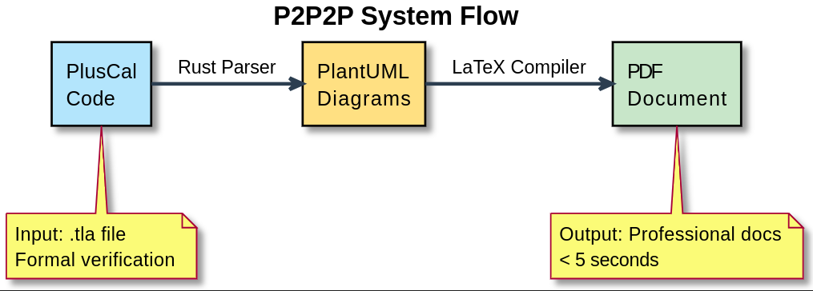
Solution - P2P2P
Notes:
Opening: To address these challenges, we developed P2P2P; an automated, end-to-end documentation pipeline.
System Flow: The process starts with PlusCal code as input, including the .tla file for formal verification. Our Rust compiler converts it into structured data, which automatically generates PlantUML diagrams. Then, a LaTeX compiler produces a professional PDF document, all in a few seconds.

Slide 8
Core Principle
If it’s not verified,
it doesn’t get documented
Notes:
Our key principle is simple:
if it’s not verified, it doesn’t get documented.

Slide 9
Value of the Solution
Key benefits
01
02
03
Time and effort savings
100% accurate diagrams consistent with verification
Encourages adoption of formal methods (PlusCal and TLA+)
Notes:
Opening: So what is the real value of this solution?
First, it dramatically reduces manual work. Documentation and diagrams are generated automatically, saving a lot of time.
Second, the diagrams are fully consistent with the formally verified specification.
Finally, it lowers the barrier to using formal methods like PlusCal and TLA+

Slide 10
Key Requirements
Functional Requirements
Automatically generate UML diagrams from verified models
Generate complete, professional PDF documentation
Integrate seamlessly into VSCode workflow
Enforce verification before documentation
System Qualities
Accurate and consistent with verified logic
Fast generation (under 60 seconds)
Deterministic and reliable outputs
Easy to use for engineers
Scalable to handle complex real-world models
Notes:
To guide our development, we focused on a small set of key requirements.
Functionally, the system needed to automatically generate diagrams and full documentation directly from verified models, while integrating seamlessly into the engineer’s workflow.
From a quality perspective, the system had to be accurate and fully consistent with the verified logic, fast enough to fit into real development cycles, and deterministic so that outputs are always reliable.
It also needed to be easy to use and scalable to handle complex, real-world models.
These requirements directly shaped our architecture and pipeline.

Slide 11
High-Level Architecture
01
02
03
VS Code Extension
As an user interface
Rust Compiler Pipeline
Orchestrates the compilation of the project and ensures correctness
LaTeX PDF
With AI insertions to document
Notes:
"To achieve these results safely, we consciously decoupled the components and built a strict three-part architecture. The VS Code Extension acts strictly as the graphical user interface, capturing user intent seamlessly and handling local file paths. This extension then orchestrates shell calls to our core Rust Compiler Pipeline executable. The Rust binary is the true heavy lifter of the project—it handles the complex parsing algorithms, the AST tree traversing, and ensuring memory-safe AST transformations. Finally, once the Rust engine achieves its end goal, we integrate standard LaTeX libraries, coupled with some fascinating future plans for AI-assisted heuristic insertions, to beautifully typeset and compile the final PDF document block."

Slide 12
Data Flow
Model.tla
Model.puml generation
Diagram.svg rendered
PASS
TLC Model Checker
Rust Pipeline
TLC Verification Gate
Model.pdf (LaTeX)
FAIL
VSCode Config (Diagram Type)
TLC Fails
Notes:
"Our internal data flow is strictly gated to ensure security and fidelity. The process initiates when a `.tla` model is passed into the external standard TLC Model Checker. This acts as a strict firewall. If TLC fails—for instance, if an arbitrary invariant is unexpectedly violated or a deadlock is reached—the memory pipeline halts the process automatically, refusing to yield a diagram. If, and only if, it passes verification, the Rust Pipeline assumes control. It parses the resulting AST, simulates the algorithm syntactically to synthesize the intermediate `.puml` diagram text artifacts, and ultimately triggers the external `pdflatex` rendering engine to stamp out the final graphical PDF."

Slide 13
Tech Stack
Integration -> VSCode
Performance & Safety -> Rust
Verification-> TLA+
Diagrams -> PlantUML
Documentation -> LaTeX
Notes:
We made a very deliberate decision early on to decouple the system into three strict layers to ensure safety, modularity, and maintainability.
At the front, we have the VS Code extension, which acts purely as the user interface. Its responsibility is simple: capture user intent, manage local file paths, and orchestrate the workflow. It does not perform any heavy computation.
All the core logic lives in our Rust pipeline. This is really the engine of the system. It handles parsing, builds and traverses the AST, and performs all transformations. We chose Rust specifically for its strong guarantees around memory safety and performance, which are critical for this kind of analysis.
Once the processing is complete, we move into the documentation layer, where we rely on LaTeX to generate high-quality PDF outputs. This gives us professional-grade typesetting, and it also opens the door to future improvements, like AI-assisted enhancements to the generated documents.
Now, in terms of data flow and safety, the key idea is that everything is strictly gated.
The process begins when a .tla model is passed to the TLC model checker. This acts as a kind of firewall. If anything goes wrong—like an invariant violation or a deadlock—the pipeline stops immediately. We never proceed with invalid models.
Only when the model is successfully verified do we continue. At that point, the Rust pipeline takes over: it parses the model, simulates the structure syntactically, and generates intermediate PlantUML artifacts.
Finally, those artifacts are rendered into diagrams and compiled into a PDF using pdflatex.
So overall, the architecture ensures that we never generate outputs from incorrect specifications, while also keeping each component cleanly separated and focused on its role.

Slide 14
Testing Strategy
Unit Testing
Integration Testing
Usability Testing
Functions in Rust modules (parser, AST, codegen)
Full Pipeline (from TLA+ to PDF)
Visual Studio Code workflow
Tests run continuously during development (CI + pre-demo validation)
Notes:
Our testing strategy is aligned with our pipeline architecture.
We validate correctness at three levels: unit testing for core logic, integration testing for the full pipeline, and usability testing to ensure engineers can effectively use the tool.
It is important to mention that all tests are continuously executed through our development cycle, ensuring stability before integration and demos.

Slide 15
Demo Scenario
1. Engineer opens a verified PlusCal model
2. Runs P2P2P inside VSCode
3. System generates UML diagrams
4. PDF documentation is automatically created
Notes:
For our demo scenario, we want to show off how an engineer might actually use our tool, so we are going to show a situation where:
An engineer creates a PlusCal model
They run the P2P2P program through the VS Code extension to see the PlantUML diagram representing the system they made
Then they can send off their PDF and accompanying package
With our addition of a hashing and verifying system, the end recipient of this diagram can then verify this package and be sure that it wasn’t modified

Slide 16
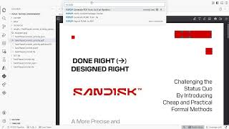
Demo
Insert Demo Video
Notes:
"To really showcase the speed and power of this toolchain, let me walk you through exactly what this looks like in practice with a live demonstration."
*(At this point, talk slowly through your video. Describe exactly what is happening in the VSCode extension. Point out the length of the `.tla` file. Show where you make a specific edit to the logic block. Show the user running the P2P2P compiler command. Verbally narrate the terminal output as it passes the TLC verification. Finally, narrate the appearance of the output LaTeX PDF and highlight how beautifully structured the automatically generated diagram is. Spend at least 3 to 4 full minutes on this slide narrating every action).*

Slide 17
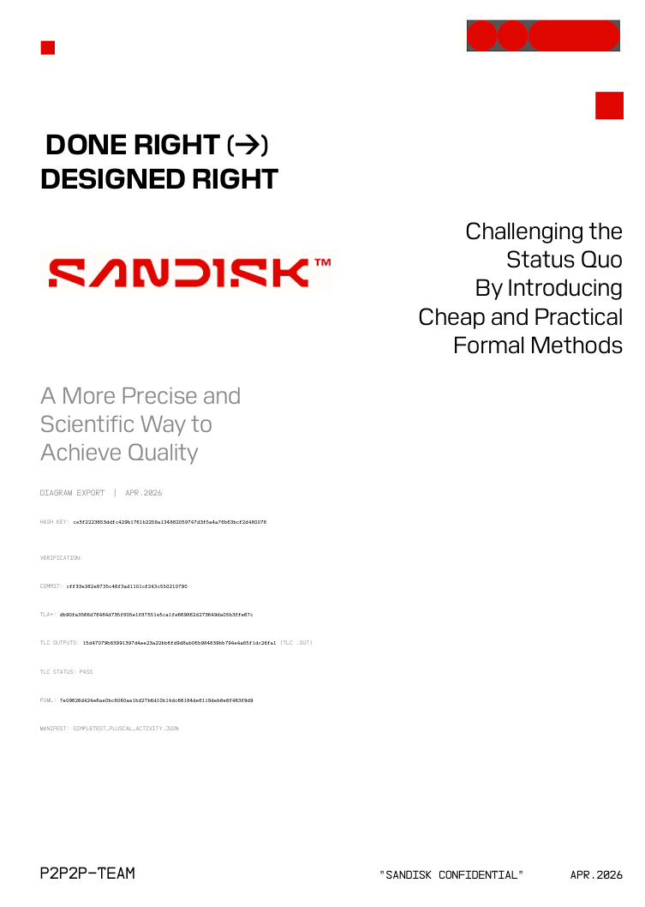
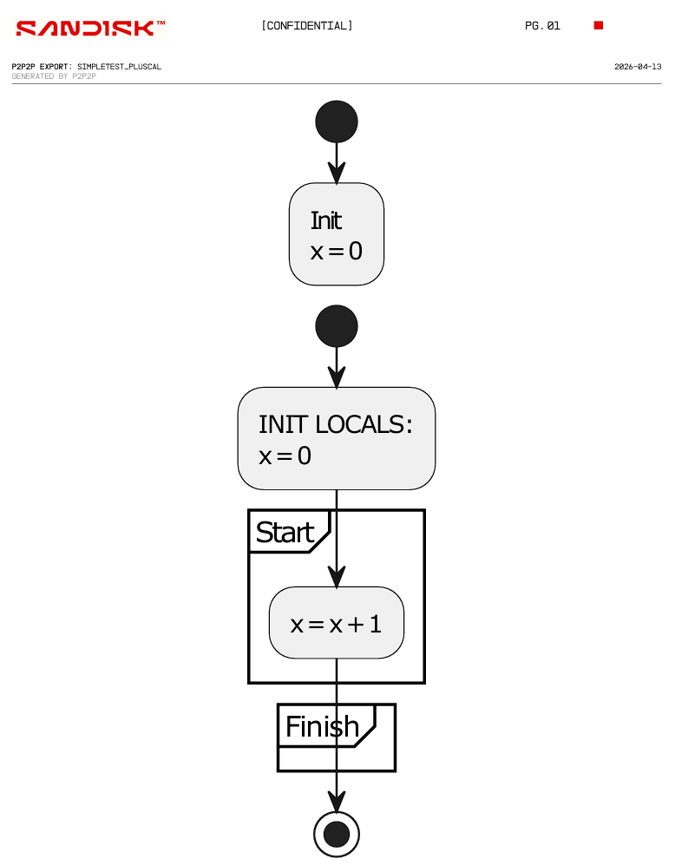
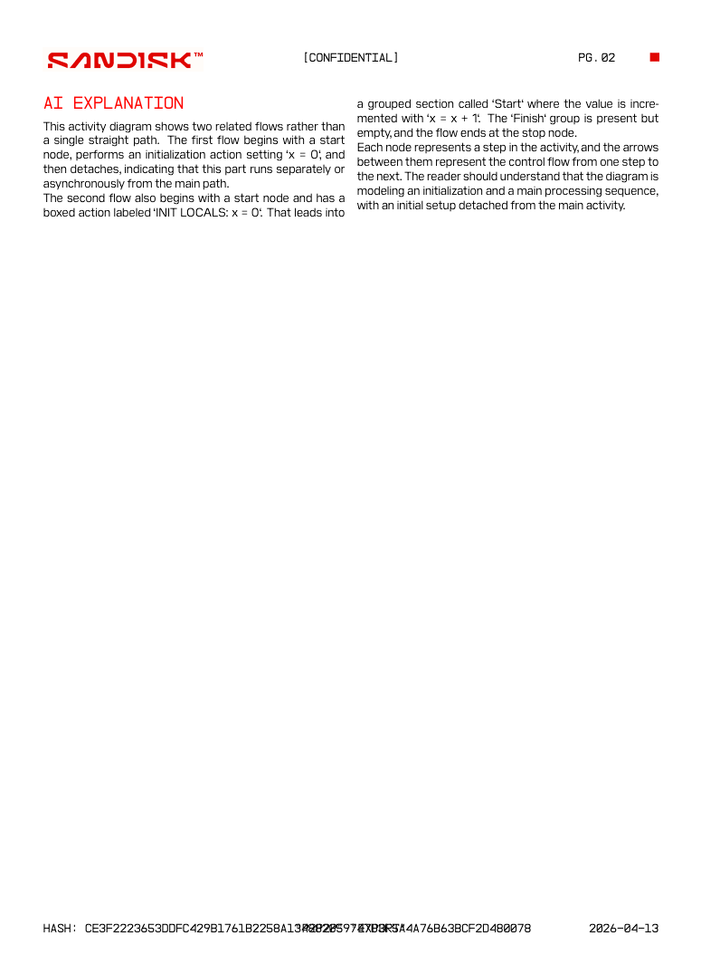
Result
Notes:
So, to recap, at the end of the pipeline, we end up with this finished document
From the left, we have our cover page with the SanDisk aesthetic, accompanied by the hashes for each of the files that accompany this PDF
Then, we have the diagram in the middle showing our PlusCal model created visually by P2P2P
Finally, we have the explanation at the end created by AI in order to save engineers some more time in creating the documentation

Slide 18
Impact
Faster Reviews
Less
Manual Work
Fewer inconsistencies
Notes:
From our P2P2P program, we believe that we have made a tool capable of aiding SanDisk in:
having quicker review processes with less human error,
along with less of a need for manual work from people, and then since this is all algorithmically created,
there will be fewer inconsistencies in documentation compared to when humans were being relied on for it.

Slide 19
Challenges
01
02
Sequence & State Diagram Complexity
Readability vs Accuracy Trade-off
Mapping PlusCal models to UML diagrams introduced challenges, especially when handling nondeterministic behavior. Ensuring accurate sequence flows and complete state transitions required careful design decisions.
Initial outputs were too technical for non-expert users.
We simplified terminology and improved clarity while maintaining correctness and alignment with the underlying model.
Notes:
For challenges we faced, we had to deal with problems that arose when dealing with these less intuitive diagrams since they are less of a direct translation over to PlantUML.
Instead, it requires some interpretation we had to decide for ourselves, especially when handling non-deterministic behaviors that came about, so it required careful decision making to ensure the quality of our output.
This leads to problems regarding tradeoffs of readability and accuracy, which is where some of that interpretation came in. This mostly came down to simplifying existing terminology to improve clarity, but still trying to maintain consistency with the underlying diagram as well as accuracy within the framework of TLA+

Slide 20
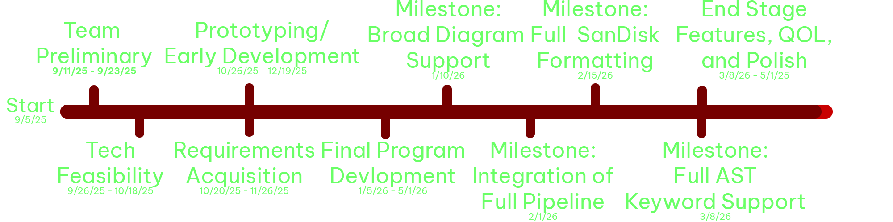
Schedule / Timeline
Notes:
For our project schedule, we were able to meet all of our milestones and deadlines throughout the process of development, and feel like we have created a quality product with a certain amount of polish and features that will help engineers and make it easier for them to work.
All the way from the inception to our project to being able to support and generate diagrams, to now having a fully featured tool, we have been able to work really well on this project and create something we are proud of.

Slide 21
Future Work
More diagram types
Better customization
Wider adoption
Notes:
Looking ahead to the upcoming year, if we were to continue working on P2P2P, our future roadmap for P2P2P would be expansive.
We would commit heavily to involving the community in adding support for far more diagram types, and focusing on providing better, much more granular stylistic customization options for the visual outputs.
Specifically, being able to match corporate company guidelines and fundamentally push integration forward for wider, mainstream adoption within large corporate and enterprise engineering divisions around the world would be our goal.
We believe that the more adoption our tool would get, and the more we could convince others to produce software with this, the better.

Slide 22
Conclusion
Architecture
Validation
Design Maturity
For the Future
Notes:
In summary, our completed system supports a fully integrated pipeline capable of generating 3 different diagram types from PlusCal models, and has thus gotten to the point of having a mature design that is malleable and robust to change.
Throughout our demonstrations, we have improved both functionality and usability, demonstrating that design, as well as better integration with the developers including all the features built directly into VS Code for the convenience of the people we are building the tool for.
Moving forward to the future, we hope to see more people see the promise that we see in this tool, and we hope that people will be influenced to move towards more thorough, and mathematically sound designs by the existence of this tool.

Slide 23
Thanks!
Do you have any questions?
Notes:
Thank you!

